Slide 1

 | S.S.V.P.S’s B. S. Deore Polytechnic, Dhule Department of Computer Engineering Academic Year : 2026-2027
SEMINAR AND PROJECT INITIATION COURSE
Sem : CO 5 K |  | SPI – 315003 | Date : 17/10/2026
Topic : AI-Powered Noise Pollution Detection and Control
Roll No. |  | Name of Student
77 |  | Ankita Jitendra Pawar
105 |  | Vaibhavi Suhas Varade
82 |  | Saad Hasham Sayyad
116 |  | Ansari Zaid Baquir Husain

Slide 2
Contents
Certificate
Abstract
Introduction
Literature Review
Information to Seminar Topic
Advantages and Disadvantages
Conclusion
Project Initiation :
6.1 Description of problem statement
6.2 Scope and objectives
6.3 Stakeholders
6.4 Seminar execution plan
6.5 Platform / Equipment / Resources identification
Bibliography
References

Slide 3
Abstract
Noise pollution harms health, but most campuses and cities check it only with occasional manual readings [3], [11]. This seminar reviews eleven papers on IoT- and AI-based noise monitoring [1]–[11]. They show that low-cost IoT nodes can classify noise sources with good accuracy using MFCC features and ML models [1], [2]. We propose a low-cost system using an ESP32 and MEMS microphone that measures noise, compares it with zone-wise limits, classifies the source with ML, and gives automatic alerts and local warnings [3], [13].

Slide 4
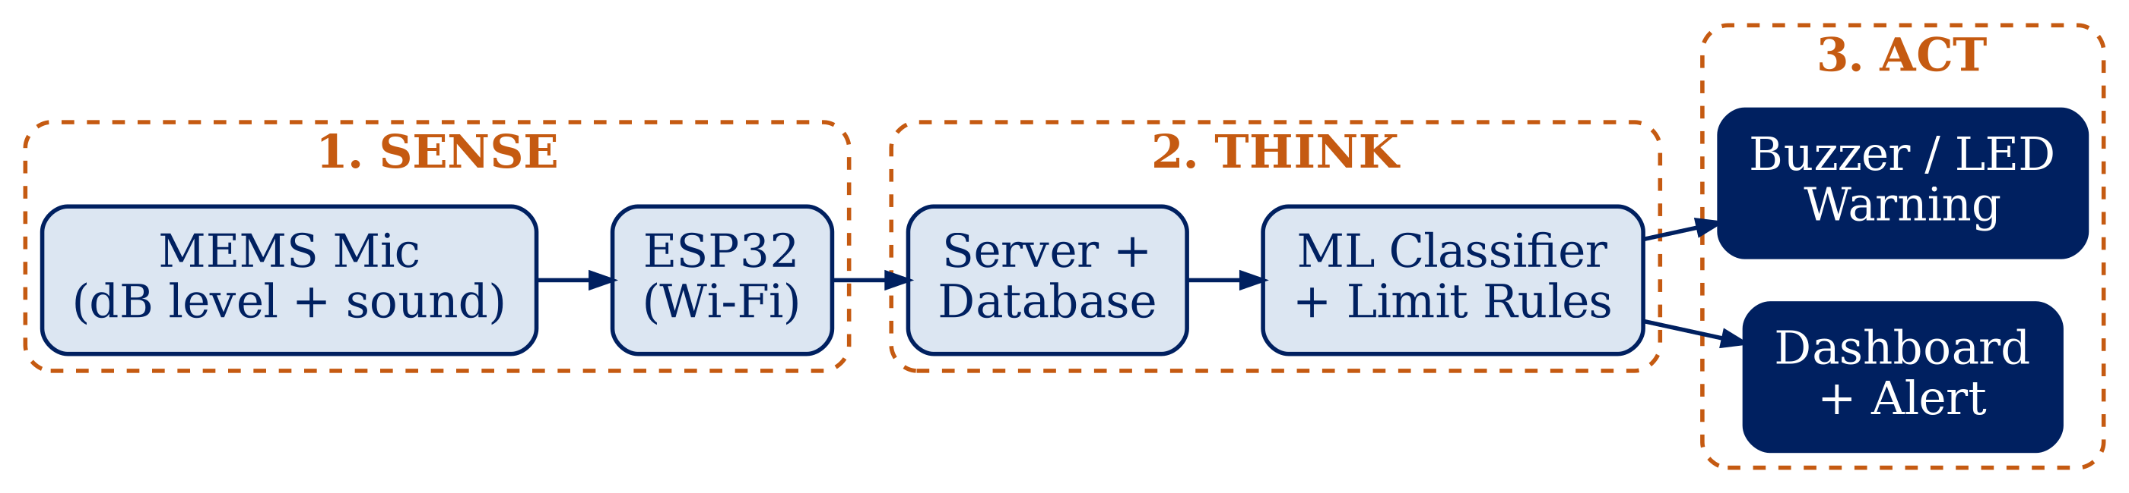
1. Introduction
Noise is unwanted sound and harms human health [11], [12].
It causes hearing damage, sleep loss and heart disease [11].
Manual meter readings cover few places and times [3], [4].
IoT microphones measure noise automatically [1], [3].
AI/ML models recognise the noise source [1], [2].
Together they enable automatic detection and control.
Fig 1: Sense – Think – Act working of the proposed system [1], [2], [3]

Slide 5
2. Literature Survey
Sr. No. | Approach Type | Technologies Used | Dataset | Key Objective | Limitations
[1] | TinyML noise source classification | Raspberry Pi, YAMNet | 657 audio clips | Real-time source identification | Single site, one week.
[2] | IoT noise identification | MFCC, SVM, KNN, Random Forest | Sound samples | Low-cost classification (88–94%) | No alerts or control.
[3] | Edge noise classification platform | STM32, MEMS mic, MLP | Urban sound data | Cheap noise collection | Prototype stage only.

Slide 6
Sr. No. | Approach Type | Technologies Used | Dataset | Key Objective | Limitations
[4] | Review of sensor networks | Wireless acoustic sensors | None (review) | Noise monitoring in smart cities | No implementation.
[5] | Review of urban sound classification | ML and DL classifiers | None (review) | Summarise methods | No new system.
[6] | BSN-ESC for AIoT | Deep neural network | Urban Sound 8K | Sound classification on AIoT | No alert or control.

Slide 7
Sr. No. | Approach Type | Technologies Used | Dataset | Key Objective | Limitations
[7] | ESC-NAS for edge devices | Neural architecture search | Urban Sound 8K | Small accurate models | No noise control.
[8] | Urban sound dataset | Taxonomy, annotated clips | Urban Sound 8K | Common research dataset | Dataset only.
[9] | Review of noise management | Sensors, big data, barriers | None (review) | Survey of approaches | No implementation.

Slide 8
Sr. No. | Approach Type | Technologies Used | Dataset | Key Objective | Limitations
[10] | ML noise classification (book) | MATLAB, Python, ML | 18 noise types, Malaysia | Monitor and classify noise | Limited to its own data.
[11] | Health effects of noise | Evidence review | None (review) | Show health impact | No monitoring system.

Slide 9
3. Information to seminar topic
Technology : Internet of Things (IoT) and Artificial Intelligence / Machine Learning [4]
Main purpose : To detect noise, find its source and warn automatically [1], [3]
Key concept : Microphone measures dB(A); ML classifies the sound using MFCC [2], [8]
Approach : ESP32 sends data to a server; limit rules and ML trigger alerts [2], [3]
Main benefit : Real-time noise monitoring without manual readings [1], [3]
Application : Campuses, hospitals, silence zones and cities [1], [9]

Slide 10
4. Advantages / Disadvantages
Advantages
Real-time noise measurement [1], [3].
Identifies the noise source [1], [2].
Supports targeted noise control [9].
Automatic alerts on limit crossing [3].
Low-cost hardware [2], [3].
Disadvantages
Microphones are not certified meters [1].
Overlapping sounds reduce accuracy [1].
Needs labelled sound data [8].
Depends on power and Wi-Fi [1].
Audio recording raises privacy concerns [1].

Slide 11
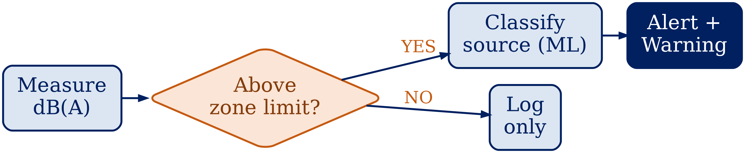
5. Conclusion
IoT and AI together turn noise monitoring from occasional manual measurement into an automatic, source-aware process. Low-cost nodes classify noise sources with 88–94% accuracy [2], and on-device TinyML reached 0.92–1.00 precision and recall in a city pilot [1]. A low-cost system that adds a simple limit-based decision step with alerts is practical and useful [3], [9].
Fig 2: Proposed decision logic – measure, compare, classify, act [1], [2], [3]

Slide 12
6. Project Initiation
This project was initiated to solve the problem of unmonitored noise in campuses, hospital zones and residential areas, where limit violations go unnoticed [3], [11].
The project aims to build a low-cost system that measures noise with an ESP32 and MEMS microphone, compares it with zone limits, classifies the source using ML, and gives alerts on a dashboard and a local warning [1], [2], [3].

Slide 13
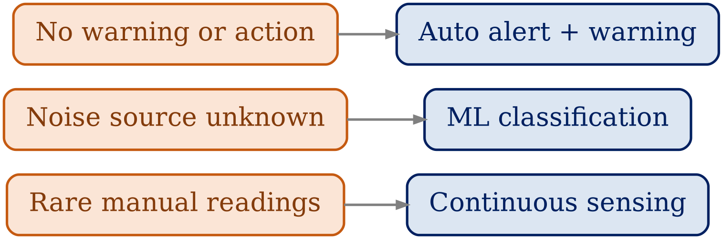
6.1 Description of Problem Statement
Noise is rarely measured continuously [3], [4].
Violations and noise sources go unnoticed [11], [13].
A low-cost auto-detect and warn system is needed [1], [3].
Fig 3: Problems of manual monitoring and the proposed fixes [3], [11]

Slide 14
6.2 Scope and Objectives
Objectives
Measure sound level continuously [1].
Send data from ESP32 to server [3].
Classify noise source using ML [2], [6].
Store readings and events in a database [10].
Alert and warn (buzzer/LED) above zone limit [9], [13].
Show live levels on a web dashboard [10].
Scope
Prototype for a campus or hospital zone [1].
Uses ESP32, MEMS mic, Flask, MySQL [3], [10].
Tested on a few sound classes [8].
Zone limits: e.g. residential 55 dB day, 45 dB night [13].

Slide 15
6.3 Stakeholders
Campus Authorities: Monitor noise and receive alerts [1].
Students and Staff: Get quieter classrooms and hostels [11].
Hospitals / Residents: Need quiet zones for health [11], [12].
Pollution Control Board: Uses data to enforce limits [13].
Urban Planners: Use noise data for planning [9].
Developers and Project Guide: Build, test and evaluate the system.

Slide 16
6.4 Seminar Execution Plan
Current Scenario: How is noise monitored today? [3], [4]
Noise Challenges: Traffic, horns and machinery harm health [11], [12].
Existing Approaches: Meters, sensors and ML used separately [2], [4].
Research Gap: Systems classify noise but rarely act on it [2], [3], [6].
Proposed System: ESP32 + mic with limit rules, ML and alerts [1], [2], [3].
Future Impact: Quieter areas and better health [11], [12].
Future Work: TinyML, mobile noise map, active control [1], [9].

Slide 17
6.5 Platform / Equipment / Resources
Hardware Requirements:
ESP32 development board [3]
MEMS microphone (I2S) [1], [3]
Buzzer / LED for local warning
Laptop / PC (8 GB RAM or more) and Wi-Fi
Software Requirements:
Operating system: Windows / Linux
Arduino IDE for ESP32 (C/C++)
Python with Flask, scikit-learn, librosa [2]
MySQL; HTML, CSS, JavaScript dashboard [10]
Visual Studio Code
Other Resources:
Research papers and Urban Sound 8K dataset [1]–[11]
Internet connection for server and alerts

Slide 18
Bibliography
Books
Internet of Things: A Hands-On Approach — Arshdeep Bahga and Vijay Madisetti.
Hands-On Machine Learning with Scikit-Learn, Keras and TensorFlow — Aurélien Géron.
Fundamentals of Acoustics — Kinsler, Frey, Coppens and Sanders.
Engineering Noise Control — David A. Bies and Colin H. Hansen.
Websites
Espressif ESP32 Documentation — docs.espressif.com
Arduino Documentation — docs.arduino.cc
scikit-learn Documentation — scikit-learn.org
Flask Documentation — flask.palletsprojects.com
UrbanSound8K Dataset — urbansounddataset.weebly.com

Slide 19
References
Research Papers
[1] Remolina Soto et al. (2025), Urban Noise Classification Using TinyML
[2] Alsouda, Pllana & Kurti (2019), IoT-Based Urban Noise Identification Using ML
[3] Baucas & Spachos (2024), Edge-Based Urban Noise Classification Platform
[4] Alías & Alsina-Pagès (2019), Wireless Acoustic Sensor Networks for Noise Monitoring
[5] Nogueira et al. (2022), Sound Classification of Urban Environments: A Review
[6] Peng et al. (2023), BSN-ESC for AIoT Applications
[7] Ranmal et al. (2024), ESC-NAS for the Edge
[8] Salamon, Jacoby & Bello (2014), A Dataset and Taxonomy for Urban Sound Research
[9] Asdrubali & D'Alessandro (2018), Noise Management in Smart Cities: A Review
[10] Albaji (2024), ML for Environmental Noise Classification in Smart Cities
[11] Basner et al. (2014), Auditory and Non-Auditory Effects of Noise on Health
Other Sources
[12] WHO Europe (2011), Burden of Disease from Environmental Noise
[13] MoEF&CC, India (2000), Noise Pollution (Regulation and Control) Rules

Slide 20
Thank you

